Slide 1
Unit 1. Passband Modulation
EL-GY 6013: Digital Communications
Prof. Sundeep rangan

Slide 2
Learning Objectives
Determine if a system is real passband or baseband
Mathematically describe upconversion and downconversion
In time-domain and frequency-domain
Compute simple continuous-time Fourier transforms (Review)
Select parameters and analyze low-pass filter in down conversion
Determine if a signal is a power or energy signal
Convert power in dBm
Compute the effective baseband filter given a passband filter
Model impairments such as time and frequency offsets

Slide 3
This Unit
Channel coding
Symbol mapping
TX filter DAC
Upconversion
Info bits
Coded bits
IQ symbols
Analog baseband
RF
Passband
Channel
Sync
Channel decoding
Symbol demod
Equalization
RX filter and ADC
Down-conversion

Slide 4
Outline
Time-Domain Relationships
Fourier Transform Review
Frequency-Domain Relationships
Power and Energy Spectra
Baseband equivalent filters
Practical up and down-conversion circuits
Wireless channels

Slide 5
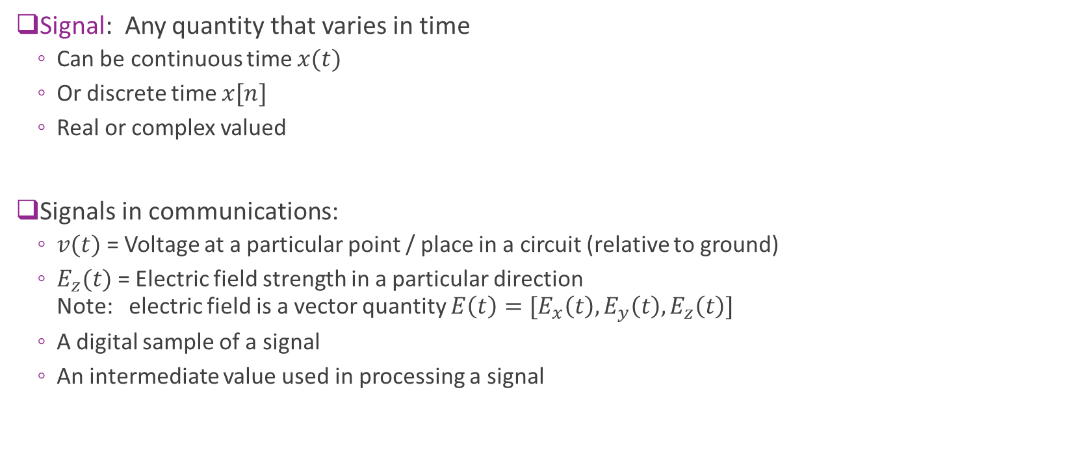
Signals in Communications
Signal: Any quantity that varies in time
Can be continuous time $x(t)$
Or discrete time $x[n]$
Real or complex valued
Signals in communications:
$v(t)$ = Voltage at a particular point / place in a circuit (relative to ground)
$E_{z}(t)$= Electric field strength in a particular direction Note: electric field is a vector quantity $E\left(t\right)=[E_{x}\left(t\right),E_{y}\left(t\right),E_{z}\left(t\right)]$
A digital sample of a signal
An intermediate value used in processing a signal

Slide 6
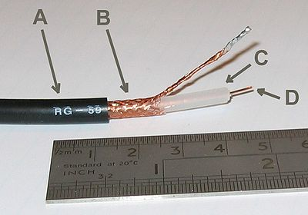
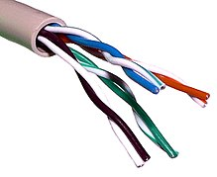
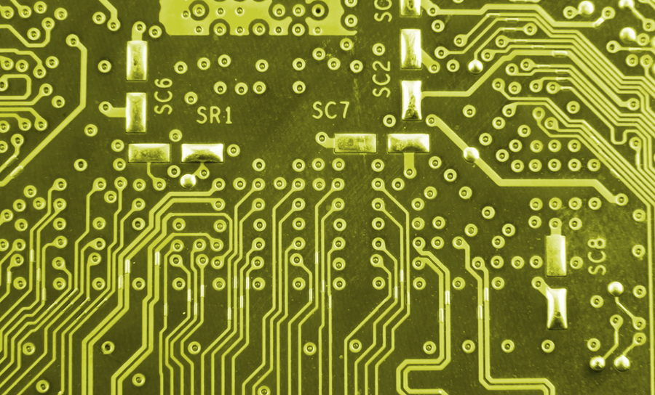
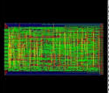
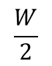
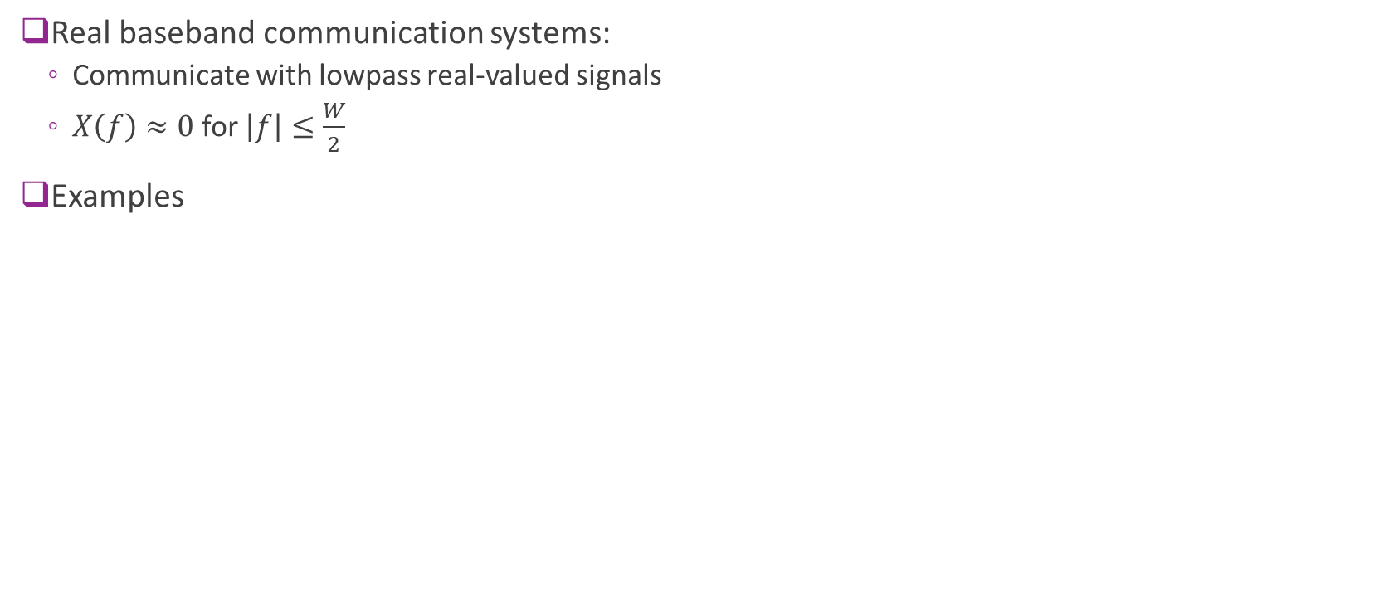
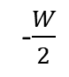
Real Baseband Systems
Real baseband communication systems:
Communicate with lowpass real-valued signals
$X\left(f\right)≈0$ for $\left|f\right|≤\frac{W}{2}$
Examples
f
-$\frac{W}{2}$
$$\frac{W}{2}$$
0
PCB traces
e.g., microstrip or stripline
ASIC metal traces
Coaxial cable
Twisted pair

Slide 7

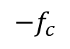
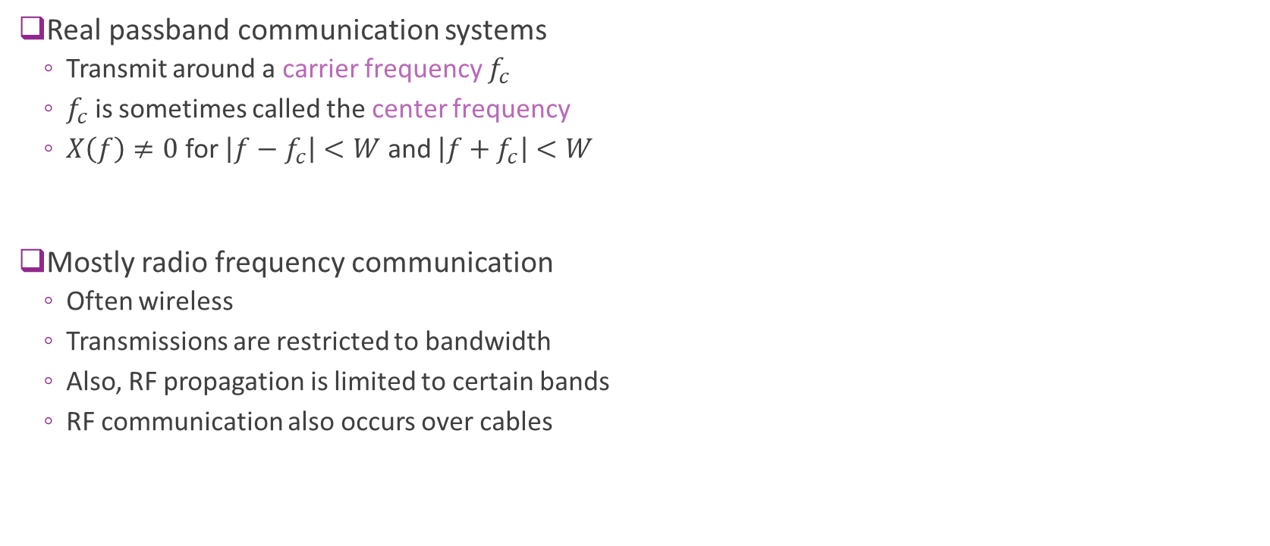
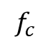
Real Passband Communications
Real passband
Real passband communication systems
Transmit around a carrier frequency $f_{c}$
$f_{c}$ is sometimes called the center frequency
$X\left(f\right)≠0$ for $\left|f−f_{c}\right|<W$ and $\left|f+f_{c}\right|<W$
Mostly radio frequency communication
Often wireless
Transmissions are restricted to bandwidth
Also, RF propagation is limited to certain bands
RF communication also occurs over cables
f
$$−f_{c}$$
0
$$f_{c}$$

Slide 8
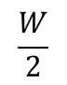
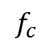
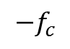
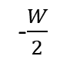
Up- and Downconversion
Baseband
Real passband
upconversion
f
f
-$\frac{W}{2}$
$$\frac{W}{2}$$
downconversion
0
$$−f_{c}$$
0
$$f_{c}$$
Up and downconversion: Shift center frequency of signals
Used for all passband communications systems
Information occurs or is processed in baseband
Transmitted and received in real passband

Slide 9
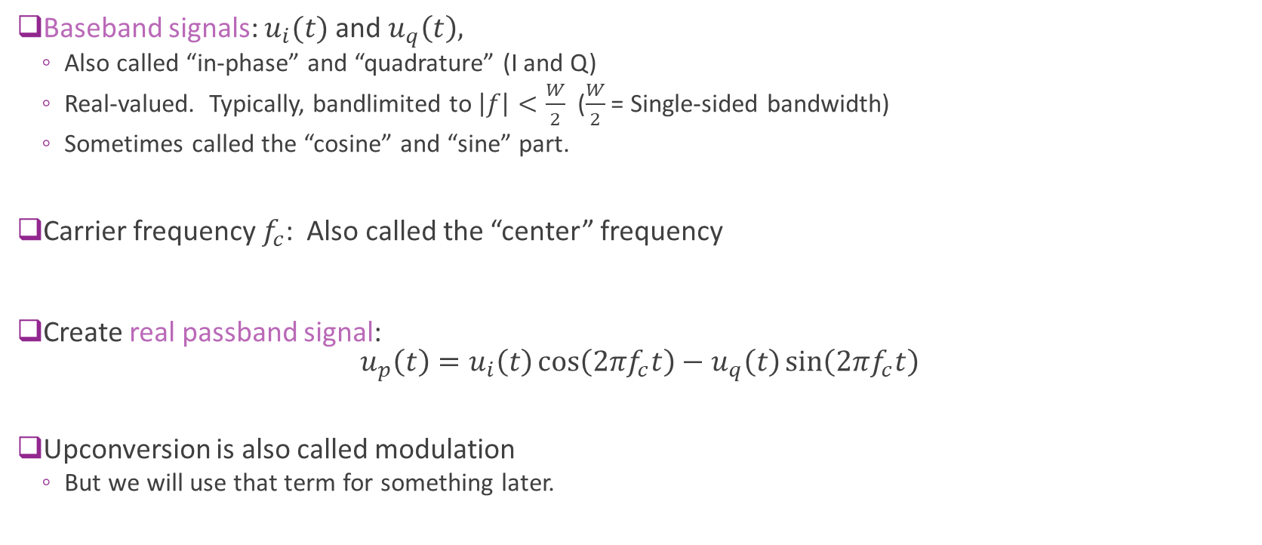
Upconversion in Time Domain
Baseband signals: $u_{i}(t)$ and $u_{q}\left(t\right),$
Also called “in-phase” and “quadrature” (I and Q)
Real-valued. Typically, bandlimited to $\left|f\right|<\frac{W}{2}$ ($\frac{W}{2}$ = Single-sided bandwidth)
Sometimes called the “cosine” and “sine” part.
Carrier frequency $f_{c}$: Also called the “center” frequency
Create real passband signal: $u_{p}\left(t\right)=u_{i}\left(t\right)\cos\left(2πf_{c}t\right)−u_{q}\left(t\right)\sin\left(2πf_{c}t\right)$
Upconversion is also called modulation
But we will use that term for something later.

Slide 10
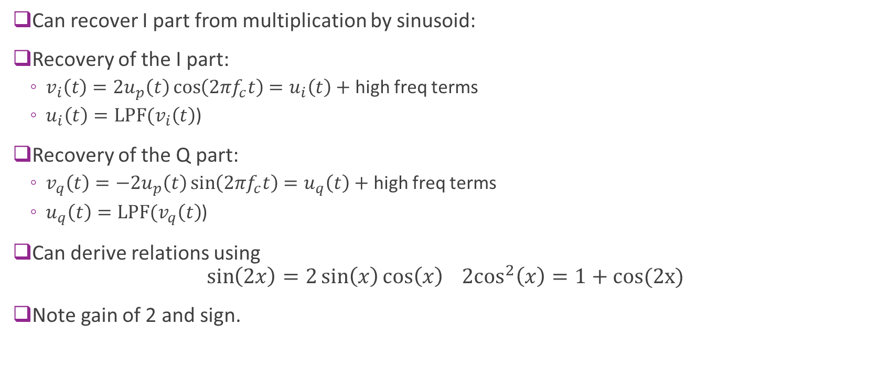
Downconversion
Can recover I part from multiplication by sinusoid:
Recovery of the I part:
$v_{i}\left(t\right)=2u_{p}\left(t\right)\cos\left(2πf_{c}t\right)=u_{i}\left(t\right)+$ high freq terms
$u_{i}\left(t\right)=LPF(v_{i}\left(t\right)$)
Recovery of the Q part:
$v_{q}\left(t\right)=−2u_{p}\left(t\right)\sin\left(2πf_{c}t\right)=u_{q}\left(t\right)+$ high freq terms
$u_{q}\left(t\right)=LPF(v_{q}\left(t\right)$)
Can derive relations using $\sin\left(2x\right)=2\sin\left(x\right)\cos\left(x\right) {2cos}^{2}\left(x\right)=1+cos(2x)$
Note gain of 2 and sign.

Slide 11
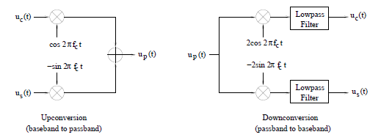
Up and Downconversion Block Diagram
Fig. 2.28 from Madhow
Implementation with multipliers

Slide 12
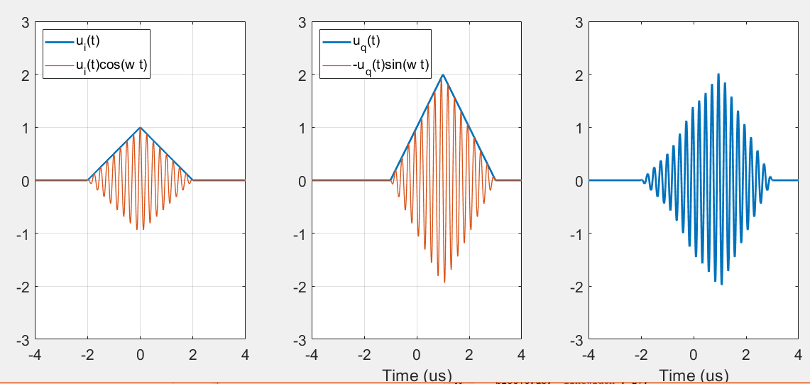
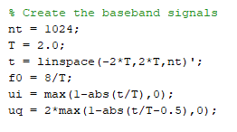
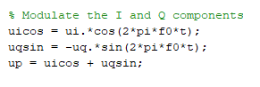
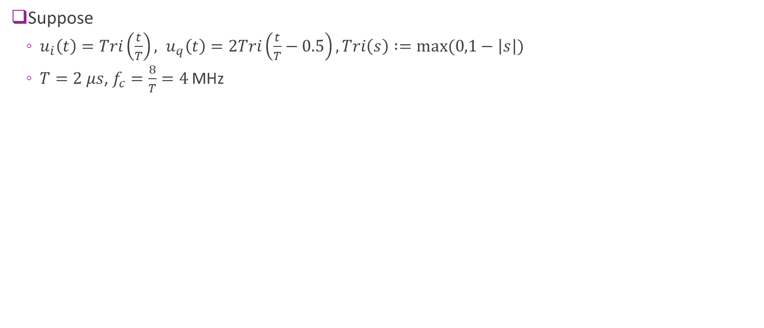
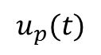
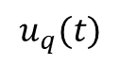
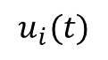
Example
Suppose
$u_{i}\left(t\right)=Tri\left(\frac{t}{T}\right), u_{q}\left(t\right)=2Tri\left(\frac{t}{T}−0.5\right), Tri\left(s\right) :=max⁡(0,1−\left|s\right|)$
$T=2$ $μs$, $f_{c}=\frac{8}{T}=4$MHz
$$u_{i}(t)$$
$$u_{q}(t)$$
$$u_{p}(t)$$

Slide 13
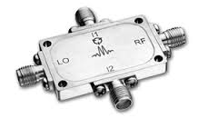
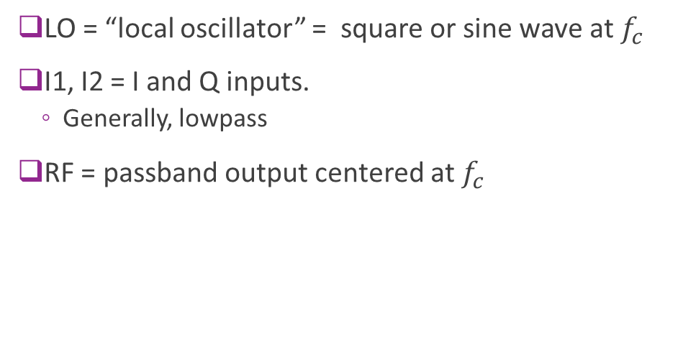
Actual IQ Mixer
LO = “local oscillator” = square or sine wave at $f_{c}$
I1, I2 = I and Q inputs.
Generally, lowpass
RF = passband output centered at $f_{c}$
http://www.markimicrowave.com/Mixers/IQ_Quadrature-IF_Double-Balanced/IQ-0318.aspx
Datasheet | RF [GHz] | LO [GHz] | IF [MHz] | Conversion Loss [dB] | Image Rejection [dB] | Amplitude Deviation [dB] | Phase Deviation [Degrees] | Isolations L-R [dB] | Isolations L-I [dB]
IQ-0318 | 3 to 18 | 3 to 18 | DC to 500 | 7 | 22 | 0.75 | 10 | 40 | 20

Slide 14
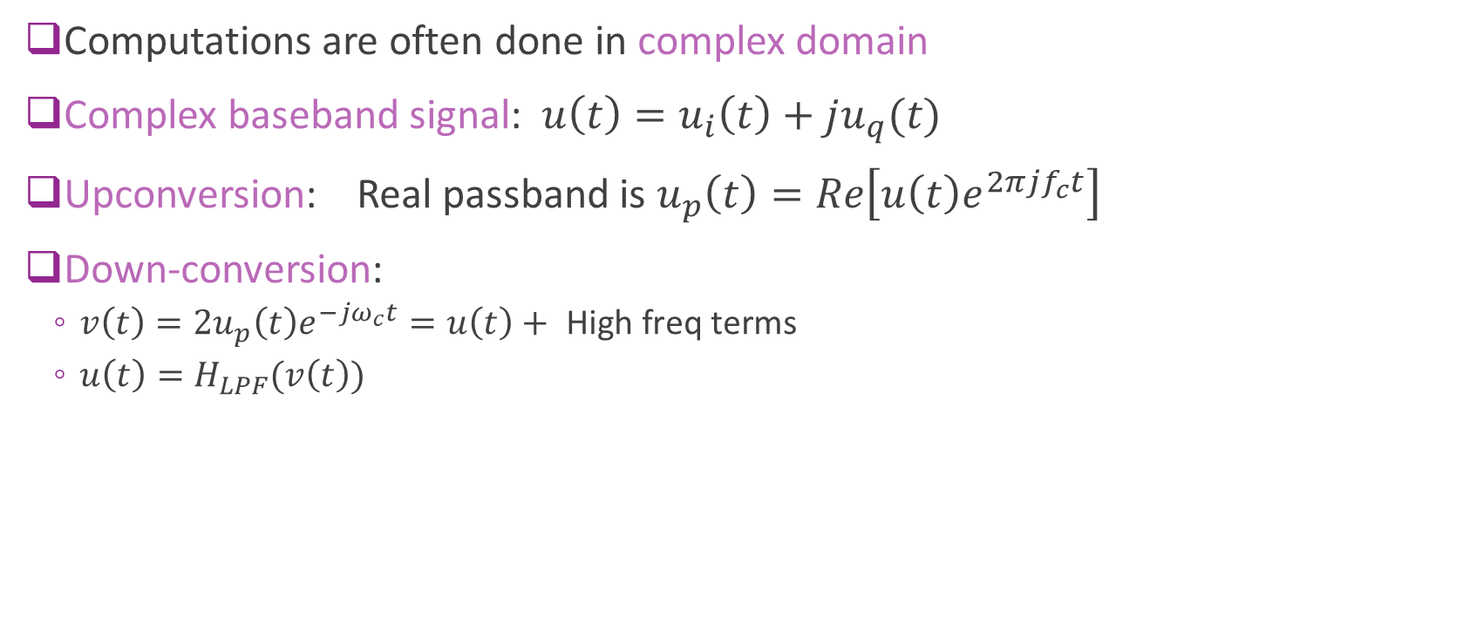
Complex Baseband Notation
Computations are often done in complex domain
Complex baseband signal: $u\left(t\right)=u_{i}\left(t\right)+ju_{q}(t)$
Upconversion: Real passband is $u_{p}\left(t\right)=Re\left[u\left(t\right)e^{2πjf_{c}t}\right]$
Down-conversion:
$v\left(t\right)=2u_{p}\left(t\right)e^{−jω_{c}t}=u\left(t\right)+ \text{High} \text{freq} \text{terms}$
$u\left(t\right)=H_{LPF}(v\left(t\right))$

Slide 15
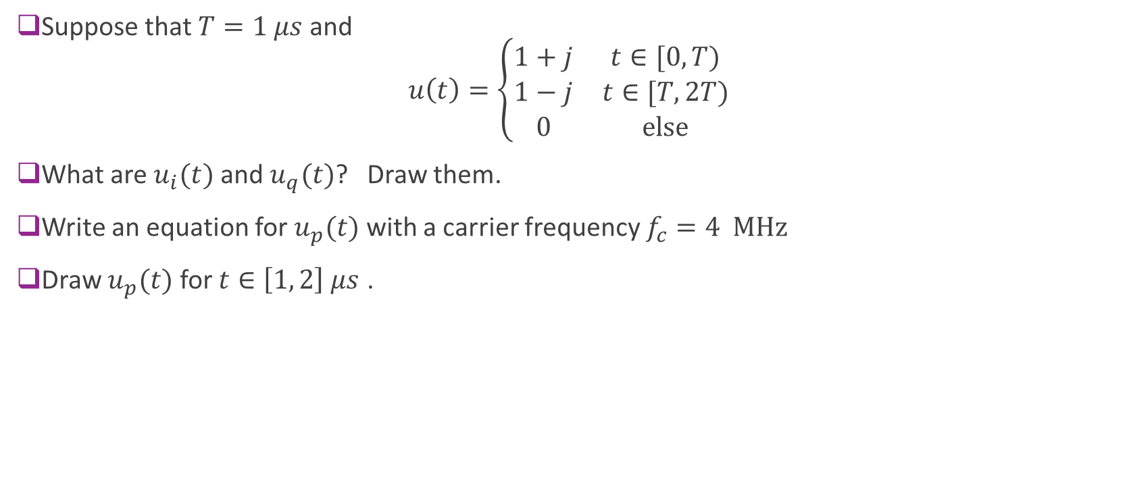
Sample Problem (Soln on Board)
Suppose that $T=1 μs$ and $u\left(t\right)=\left\{\begin{matrix}1+j & t∈[0,T) \\ 1−j & t∈[T,2T) \\ 0 & \text{else}\end{matrix}\right.$
What are $u_{i}(t)$ and $u_{q}(t)$? Draw them.
Write an equation for $u_{p}(t)$ with a carrier frequency $f_{c}=4 MHz$
Draw $u_{p}(t)$ for $t∈\left[1, 2\right] μs$ .

Slide 16
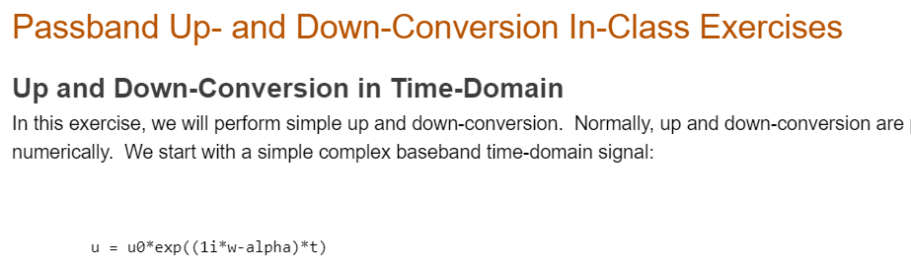
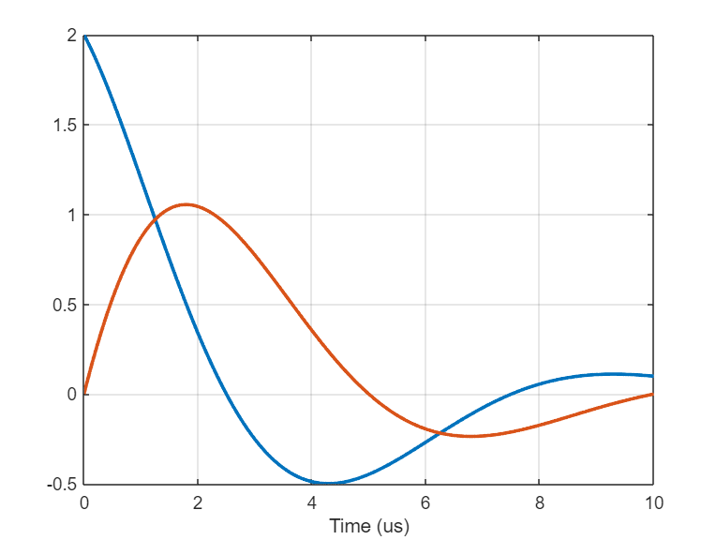
In-Class Exercise
See passbandInClass.mlx MATLAB live script
Fill in TODO sections

Slide 17
Outline
Time-Domain Relationships
Fourier Transform Review
Frequency-Domain Relationships
Power and Energy Spectra
Baseband equivalent filters
Practical up and down-conversion circuits
Wireless channels

Slide 18
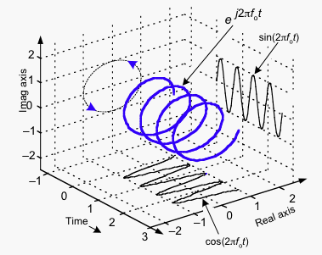
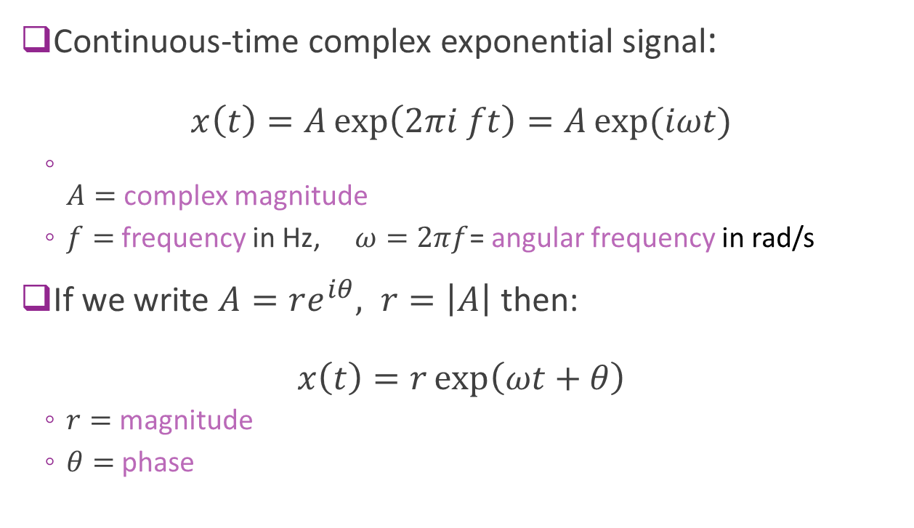
Complex Exponential
Continuous-time complex exponential signal: $x\left(t\right)=A\exp\left(2πi ft\right)=A\exp{(iωt)}$
$A=$ complex magnitude
$f=$ frequency in Hz, $ω=2πf$= angular frequency in rad/s
If we write $A=re^{iθ}, r=\left|A\right|$ then: $x\left(t\right)=r\exp\left(ωt+θ\right)$
$r=$ magnitude
$θ=$ phase

Slide 19
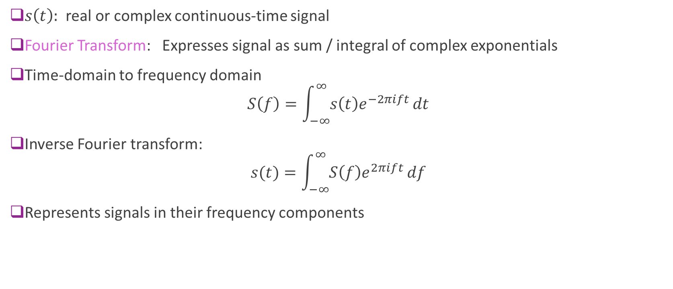
Fourier Transform
$s\left(t\right):$ real or complex continuous-time signal
Fourier Transform: Expresses signal as sum / integral of complex exponentials
Time-domain to frequency domain $S\left(f\right)=\int_{−∞}^{∞}{s\left(t\right)e^{−2πift}}dt$
Inverse Fourier transform: $s(t)=\int_{−∞}^{∞}{S\left(f\right)e^{2πift}}df$
Represents signals in their frequency components

Slide 20
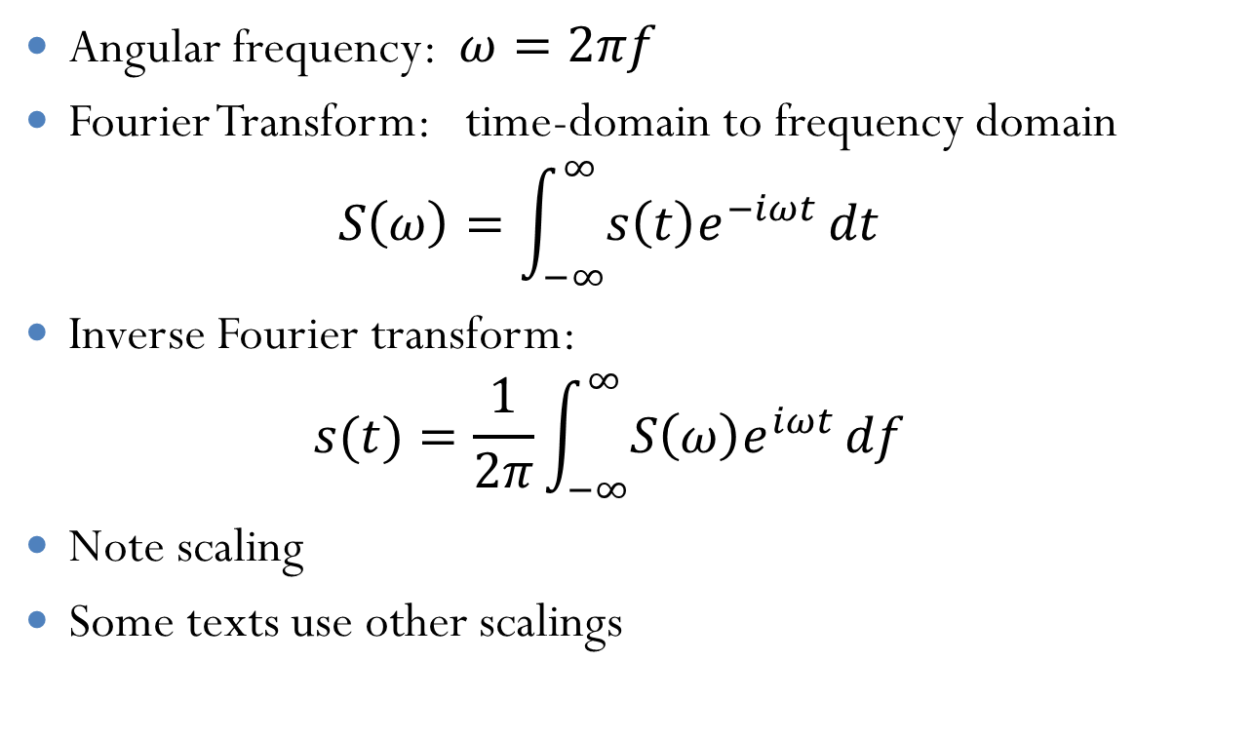
FT in Angular Frequency
Angular frequency: $ω=2πf$
Fourier Transform: time-domain to frequency domain $S\left(ω\right)=\int_{−∞}^{∞}{s\left(t\right)e^{−iωt}}dt$
Inverse Fourier transform: $s(t)=\frac{1}{2π}\int_{−∞}^{∞}{S\left(ω\right)e^{iωt}}df$
Note scaling
Some texts use other scalings

Slide 21
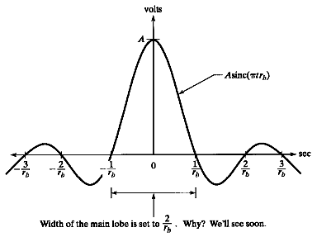
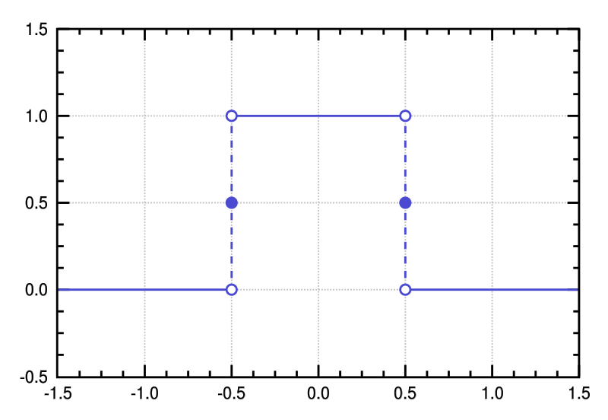
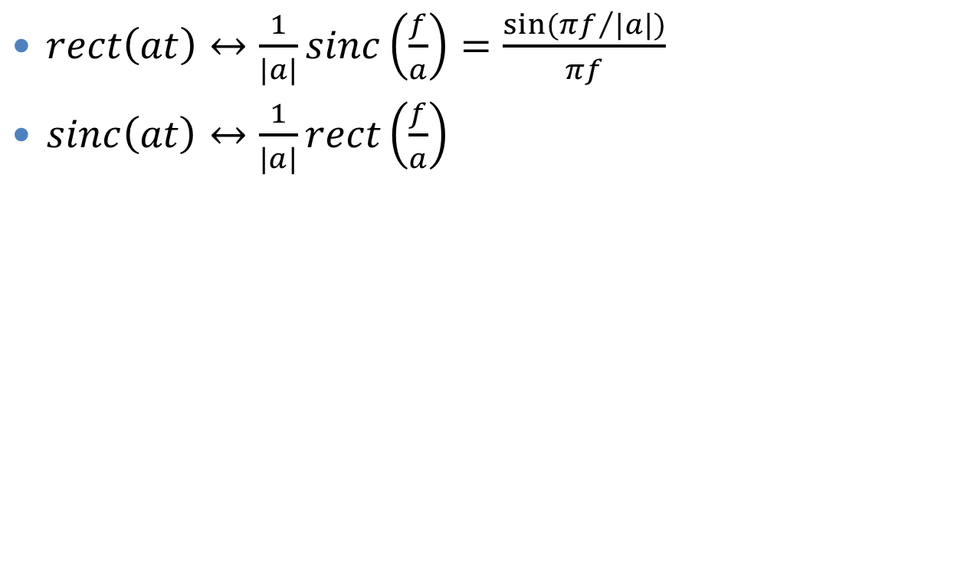
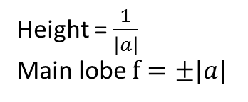
Rect and Sinc
Height = $\frac{1}{\left|a\right|}$ Main lobe $f=±|a|$
$rect\left(at\right)↔\frac{1}{|a|}sinc\left(\frac{f}{a}\right)=\frac{\sin{({πf}/{|a|})}}{πf}$
$sinc\left(at\right)↔\frac{1}{|a|}rect\left(\frac{f}{a}\right)$

Slide 22
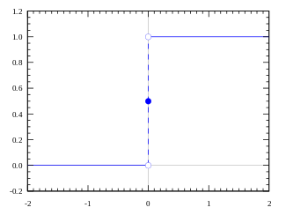
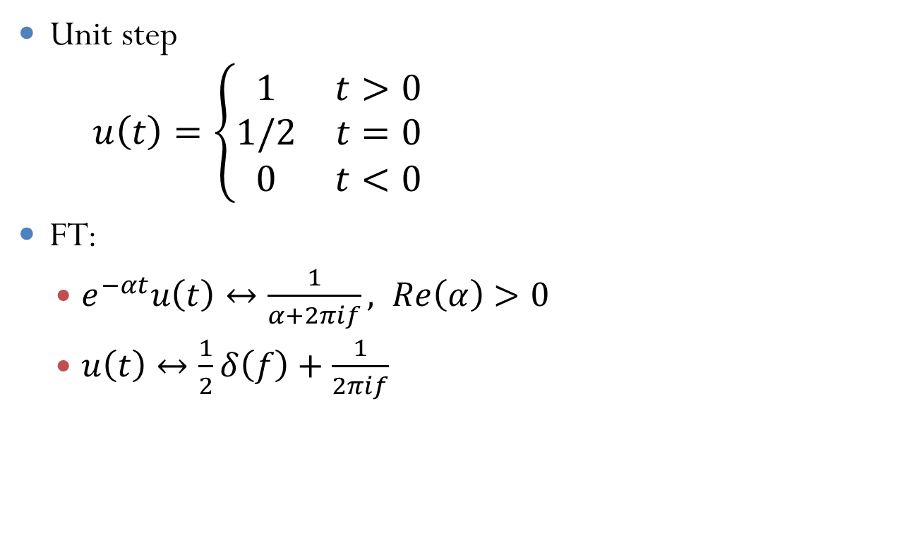
Unit Steps
Unit step $u\left(t\right)=\left\{\begin{matrix}1 & t>0 \\ 1/2 & t=0 \\ 0 & t<0\end{matrix}\right.$
FT:
$e^{−αt}u\left(t\right)↔\frac{1}{α+2πif}, Re\left(α\right)>0$
$u\left(t\right)↔\frac{1}{2}δ\left(f\right)+\frac{1}{2πif}$

Slide 23
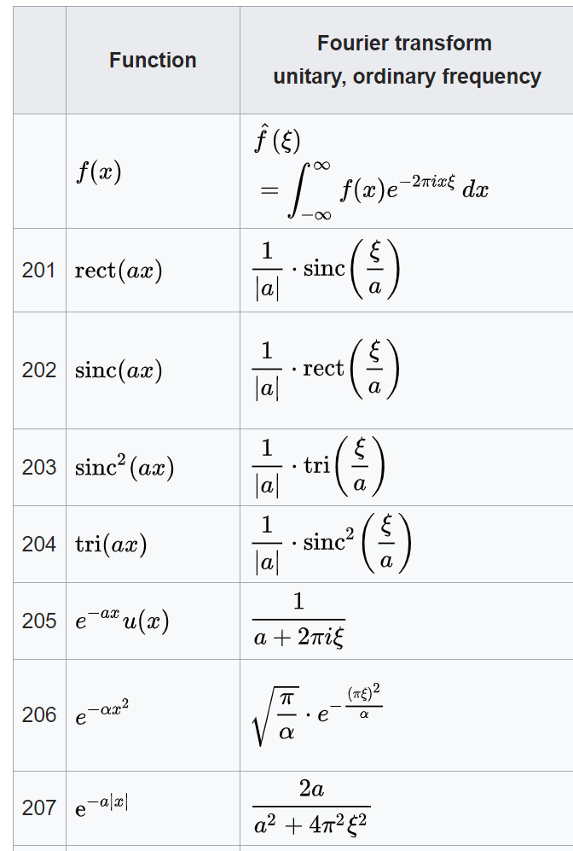
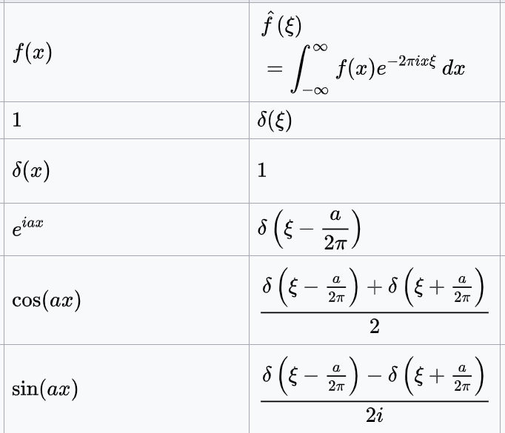
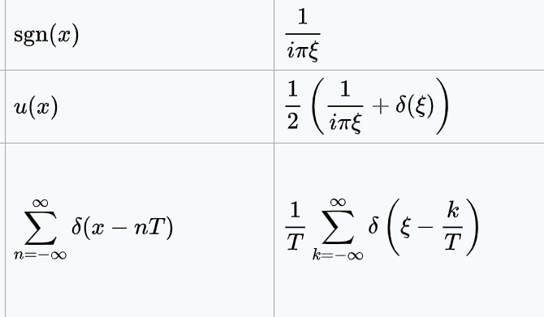
Table (From WikiPedia)

Slide 24
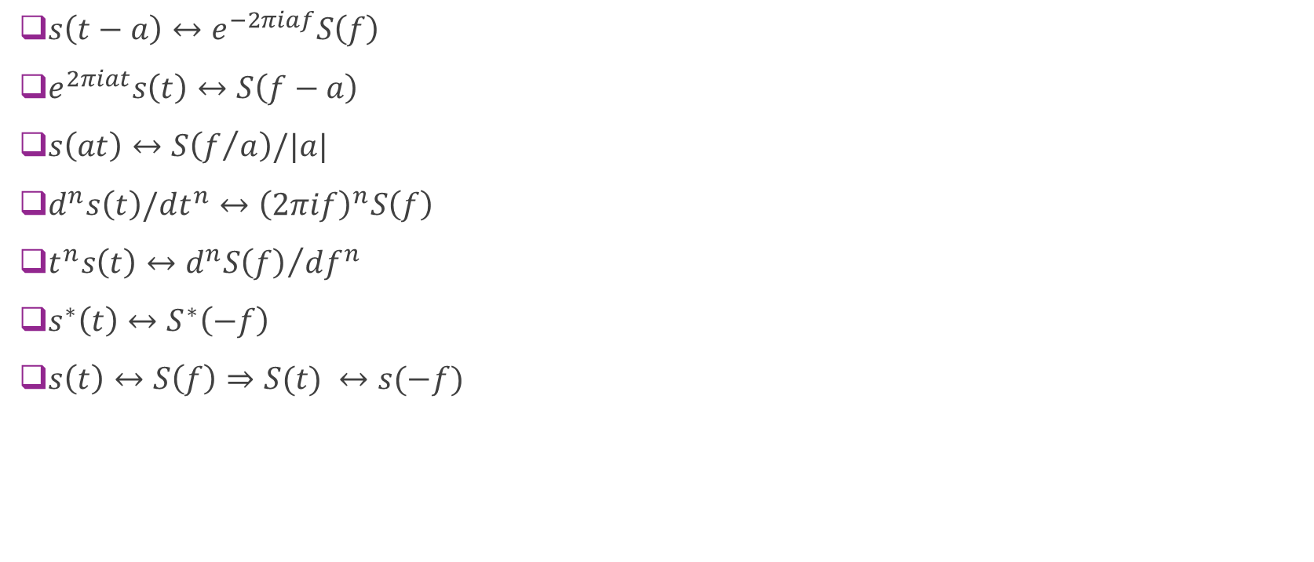
Other Properties
$s\left(t−a\right)↔e^{−2πiaf}S\left(f\right)$
$e^{2πiat}s\left(t\right)↔S\left(f−a\right)$
$s\left(at\right)↔S\left(f/a\right)/|a|$
$d^{n}s\left(t\right)/dt^{n}↔{\left(2πif\right)}^{n}S\left(f\right)$
$t^{n}s\left(t\right)↔{d^{n}S\left(f\right)}/{df^{n}}$
$s^{∗}\left(t\right)↔S^{∗}\left(−f\right)$
$s\left(t\right)↔S\left(f\right)⇒S(t) ↔s(−f)$

Slide 25
Problems
Solutions on board

Slide 26
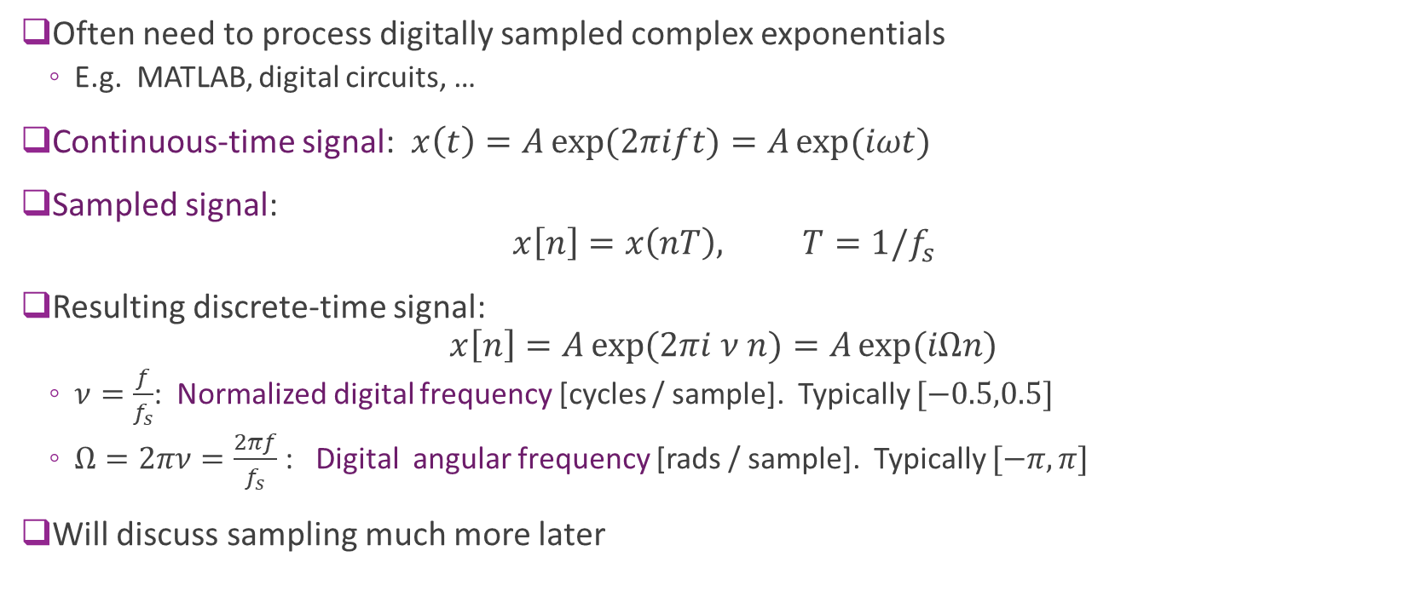
Sampled Complex Exponentials
Often need to process digitally sampled complex exponentials
E.g. MATLAB, digital circuits, …
Continuous-time signal: $x\left(t\right)=A\exp{(2πift)}=A\exp{(iωt)}$
Sampled signal: $x\left[n\right]=x\left(nT\right), T=1/f_{s}$
Resulting discrete-time signal: $x\left[n\right]=A\exp{(2πi ν n)}=A\exp{(iΩn)}$
$ν=\frac{f}{f_{s}}$: Normalized digital frequency [cycles / sample]. Typically $[−0.5,0.5]$
$Ω=2πν=\frac{2πf}{f_{s}}$ : Digital angular frequency [rads / sample]. Typically $[−π,π]$
Will discuss sampling much more later

Slide 27
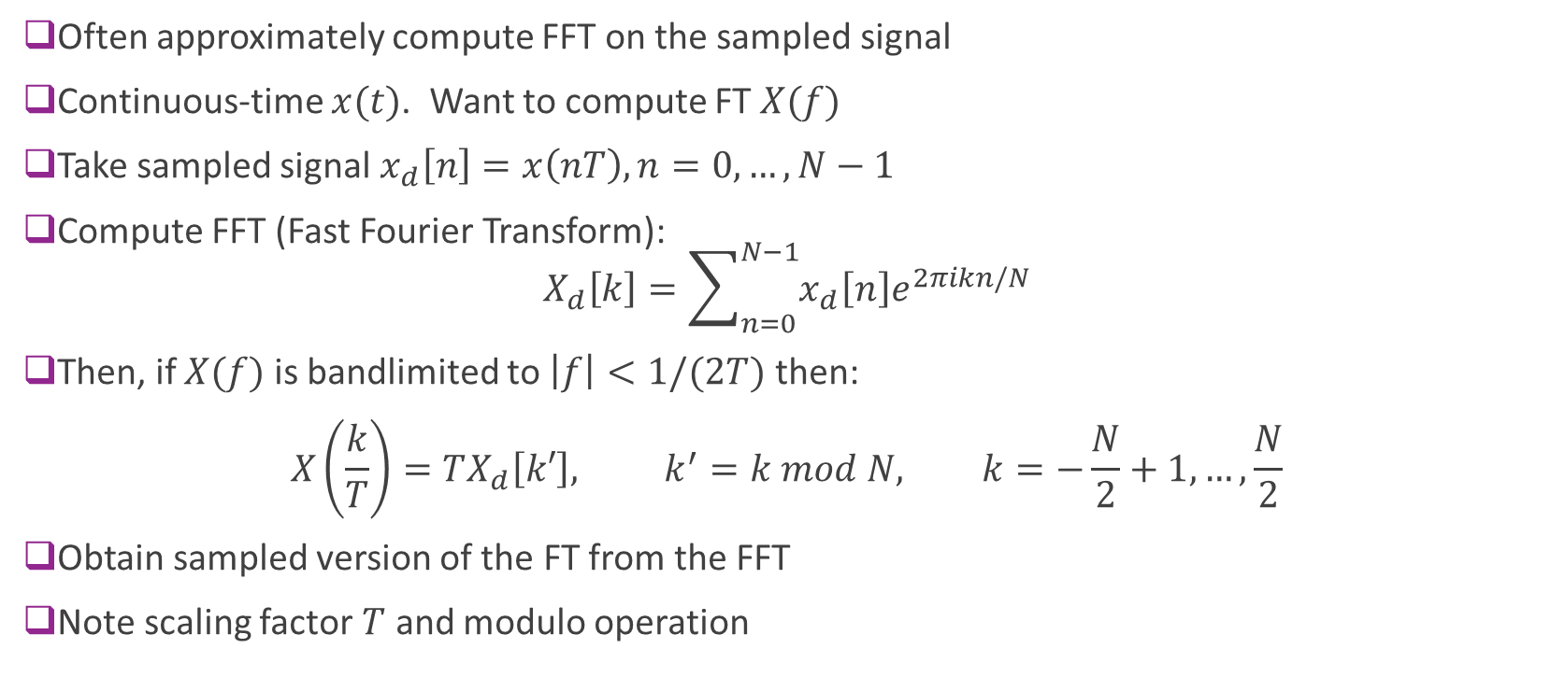
Computing the FT with the FFT
Often approximately compute FFT on the sampled signal
Continuous-time $x(t)$. Want to compute FT $X(f)$
Take sampled signal $x_{d}\left[n\right]=x\left(nT\right), n=0,…,N−1$
Compute FFT (Fast Fourier Transform): $X_{d}\left[k\right]=\sum_{n=0}^{N−1}{x_{d}\left[n\right]e^{2πikn/N}}$
Then, if $X(f)$ is bandlimited to $\left|f\right|<1/(2T)$ then: $X\left(\frac{k}{T}\right)=TX_{d}\left[k′\right], k^{′}=k mod N, k=−\frac{N}{2}+1,…,\frac{N}{2}$
Obtain sampled version of the FT from the FFT
Note scaling factor $T$ and modulo operation

Slide 28
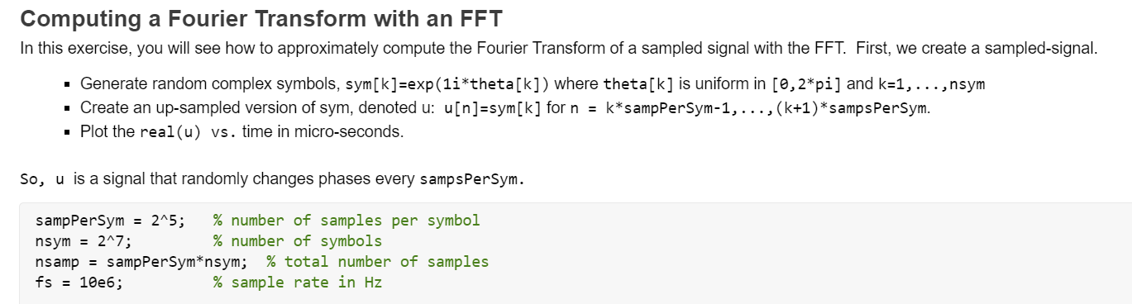
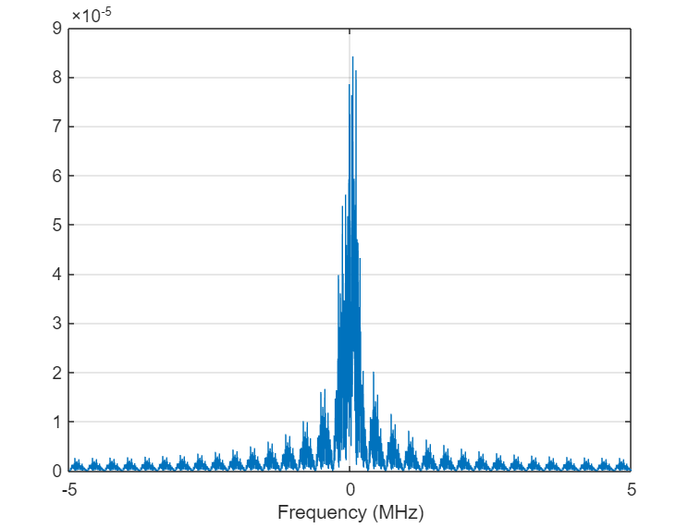
In-Class Exercise

Slide 29
Outline
Time-Domain Relationships
Fourier Transform Review
Frequency-Domain Relationships
Power and Energy Spectra
Baseband equivalent filters
Practical up and down-conversion circuits
Wireless channels

Slide 30
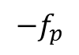






Up-Conversion of a Complex Exponential
Suppose complex baseband is $u\left(t\right)=A\exp{(2πift)}$
Up-conversion: $u_{p}\left(t\right)=Real\left( u\left(t\right) e^{2πi f_{c}t} \right)=A\cos{(2πif_{p}t)}$
Shifts $f$to $f_{p}=f+f_{c}$
Can write as $u_{p}\left(t\right)=\frac{A}{2}\left[e^{2πif_{p}t}+e^{−2πif_{p}t}\right]$
If $u\left(t\right)=A\exp{(2πift+θ)}$ then $u_{p}\left(t\right)=A\cos{(2πi\left(f+f_{c}\right)t+θ)}$
Phase is unchanged
Down-conversion reverses the process
$$A$$
$$f$$
Up-conversion
$$A/2$$
$$A/2$$
$$−f_{p}$$
$$f_{p}=f+f_{c}$$

Slide 31











Down-Conversion of a Complex Exponential
From previous slide, after upconversion:
$$u_{p}\left(t\right)=\frac{A}{2}\left[e^{2πif_{p}t}+e^{−2πif_{p}t}\right]$$
Mixing: $v\left(t\right)=2u_{p}\left(t\right)e^{2πif_{c}t}$ $=Ae^{2πift}+Ae^{−2πi\left({f+2f}_{c}\right)t}$
Filtering: $u\left(t\right)=LPF\left(v\left(t\right)\right)=Ae^{2πift}$
$$A/2$$
$$A/2$$
$$f$$
$$−f_{p}$$
$$f_{p}=f+f_{c}$$
Mixing
$$A$$
$$A$$
$$f−2f_{c}$$
Filtering
$$A$$
$$f$$

Slide 32

Example
Suppose the digital complex baseband signal is: $u\left[n\right]=A\exp{(2πiνn)}$
$ν=0.1,$ $A=4$
Suppose sampling rate is $f_{s}=20$ MHz and carrier is $f_{c}=2$GHz
What is the continuous-time complex baseband signal?
Ans: $u\left(t\right)=A\exp{(2πi ft)}, f=νf_{s}=\left(0.1\right)\left(20\right)=2$ MHz
What is the real passband signal after up-conversion?
Ans: $u_{p}\left(t\right)=A\exp{(2πi f_{p}t)}, f_{p}=f+f_{c}=2.002$ GHz
Be careful with units

Slide 33








Bandwidth Terminology
Now consider more complex signals
Baseband signals
Centered around $f=0,$ complex
$\frac{W}{2}=$ single sided bandwidth
$W=$ two sided bandwidth
Band-limited to $\left|f\right|≤\frac{W}{2}$
Passband signals
Centered around $f=f_{c},$ real
$W=$ bandwidth (per side or image)
Band-limited to $\left|{f−f}_{c}\right|≤\frac{W}{2}$
$$U(f)$$
$$−\frac{W}{2}$$
0
$$\frac{W}{2}$$
$$U(f)$$
$${−f}_{c}$$
0
$$f_{c}$$
$$W$$

Slide 34


Importance of Bandwidth
Data rate generally scales linearly in bandwidth
If the transmit power and bandwidth increase by $N$ $⇒$ the communication rate increases by $N$
We will see this in detail later
Ex: Compare GSM (2G) and LTE (4G)
Single channel of GSM system = 200 kHz
Single channel of LTE = 20 MHz
If power scales sufficiently, LTE would in general have 100x data rate
LTE, in fact, can have even more capacity due to other improvements
Figure to the right: 802.11ad channels
The channels are > 2 GHz

Slide 35

Frequency Domain Relationships Baseband to Passband
Suppose that $U\left(f\right)$ is bandlimited to $\left[−\frac{W}{2},\frac{W}{2}\right]$ and $f_{c}>W$ $U_{p}\left(f\right)=\frac{1}{2}\left[U\left(f−f_{c}\right)+U^{∗}(−f−f_{c})\right]$
Use notation:
$U^{+}\left(f\right)≔\frac{1}{2}U\left(f−f_{c}\right):$This is $U(f)$ shifted to the right by $f_{c}$ and scaled by $\frac{1}{2}$
$U^{−}\left(f\right)≔\frac{1}{2}U^{∗}\left(−f−f_{c}\right)$: Flip $U^{+}(f)$ around $y$ axis and take negative of the imaginary part
Proof:
Let $c\left(t\right)=u\left(t\right)e^{2πjf_{c}t}↔C\left(f\right)=U(f−f_{c})$
$u_{p}\left(t\right)=Re\left(c\left(t\right)\right)=\frac{1}{2}\left(c\left(t\right)+c^{∗}\left(t\right)\right)$
Now use conjugate symmetry $c^{∗}\left(t\right)↔C^{∗}(−f)$

Slide 36





Example Problem
Suppose baseband signal is as drawn:
What is the:
Single-sided bandwidth?
Two-sided bandwidth?
Write an equation for $u_{i}(t)$
You do not need to evaluate the integral.
Draw the passband frequency response if $f_{c}=2$ GHz
Draw both the positive and negative images
$$\text{Real}(U\left(f\right))$$
$$\text{Imag}(U\left(f\right))$$
$$A$$
$$B$$
-10 MHz
0
10 MHz
0
5 MHz
-5

Slide 37

Frequency Domain Relationships Passband to Baseband
Downcoversion in time-domain: $v\left(t\right)=2u_{p}\left(t\right)e^{−jω_{c}t}, u\left(t\right)=h_{LPF}(t)∗v\left(t\right)$
In frequency-domain: $U\left(f\right)={2U}_{p}\left(f+f_{c}\right)H_{LPF}(f)$
Shift to left, scale by 2 and filter
Ideal filtering:
Suppose $U_{p}\left(f\right)$ has bandwidth $W$ around $f_{c}$
Then typically have: $H_{LPF}\left(f\right)=1$ for $\left|f\right|≤\frac{W}{2}$ and $H_{LPF}\left(f\right)=0$ for $\left|f\right|>f_{c}−\frac{W}{2}$
$U\left(f\right)={2U}_{p}\left(f+f_{c}\right)1_{\{\left|f\right|≤W\}}$
Shift to the left and remove left image.
Pictures on board

Slide 38




Example Problem
Suppose right image of passband is as shown:
$W=4$ MHz, $f_{c}=$ 800 MHz
Assume a LPF $H_{LPF}\left(f\right)=Rect\left(\frac{f}{f_{0}}\right)$
Draw magnitude spectrum of down-converted signal
When $f_{0}=5$ MHz
When $f_{0}=3$ MHz
What range of values $f_{0}$ will:
Keep the low-pass component
Reject the high frequency component
Solution on board
A
$$|U\left(f\right)|$$
0
$$f_{c}$$
$$W$$

Slide 39

Radio Spectrum

Slide 40
Bandwidth and Center Frequencies Examples
System | Duplex | Center freq (MHz) | Bandwidth
GSM | FDD | GSM-850: 824-849 (UL), 869-894 (DL) GSM-900: 890-914 (UL), 935-959 (DL) GSM-1800: 1710–1784(UL), 1805.2–1879(DL) GSM-1900: 1850–1910(UL), 1930–1990(DL) | 200 kHz per channel
UMTS | FDD | GSM + other bands ~2100 and ~1900 | 5 MHz per carrier
LTE | Mostly FDD | Mostly in 2100 to 2600 MHz | 1.4 to 20 MHz, 10 MHz typical
802.11abg | TDD | 2.4 GHz (ISM band) and 5 GHz (U-NII band) | 20 MHz
802.11n |  |  | 20, 40 MHz
802.11ac |  |  | 20-160 MHz
802.11ad | TDD | 60 GHz (millimeter wave spectrum) | 2.16 GHz

Slide 41

Millimeter Wave
New bands for 5G
100x more bandwidth than conventional bands below 6 GHz
5G systems today are operating in 28 GHz and 38 GHz

Slide 42

Upper Mid-Band
New frequency band of interest
Balance of coverage and spectrum
Many research challenges
Spectrum sharing
Wide bandwidth
Resiliency

Slide 43
Outline
Time-Domain Relationships
Fourier Transform Review
Frequency-Domain Relationships
Power and Energy Spectra
Baseband equivalent filters
Practical up and down-conversion circuits
Wireless channels

Slide 44

Energy and Power Signals
Instantaneous power: ${\left|x\left(t\right)\right|}^{2}$
Why squared?
Energy:
$E_{x}=\int_{−∞}^{∞}{{\left|x\left(t\right)\right|}^{2}dt}$
Signal is called an “energy signal” if $E_{x}<∞$
Power:
$P_{x}=\lim_{T→∞}{\frac{1}{T}}\int_{−T/2}^{T/2}{{\left|x\left(t\right)\right|}^{2}dt}$
Energy per unit time
Signal is called a “power signal” if limit $P_{x}$ exists and is finite

Slide 45

Power of a Periodic Signal Time-Domain Method
Suppose $x(t)$ is periodic, period $T$
Theorem: $x(t)$ is a power signal and power can be computed from any one period
$$P_{x}=\frac{1}{T}\int_{0}^{T}{{\left|x\left(t\right)\right|}^{2}dt}=\frac{1}{T}\int_{t_{0}}^{t_{0}+T}{{\left|x\left(t\right)\right|}^{2}dt}$$
Proof on board

Slide 46

Example: Done on board
Suppose that $x\left(t\right)$ has period $T$ $x\left(t\right)=a+bt, t∈\left[0,T\right]$
$a,b$ are real
Draw $x\left(t\right)$
What is $P_{x}$
What if $a,b$ were complex?

Slide 47

Power of a Periodic Signal Fourier Series Method
Suppose that $x\left(t\right)$ is periodic with period $T$
Then has Fourier Series $x\left(t\right)=∑c_{n}e^{2πjf_{n}t}, f_{n}=n/T$
Theorem: Power of $x\left(t\right)$ is: $P_{x}=∑{\left|c_{n}\right|}^{2}$
Note that if $x\left(t\right)=∑g\left(t−nT\right),$ then $c_{n}=G(f_{n})$
Can compute power from Fourier transform of $g(t)$

Slide 48

Example: On board
Suppose $T=10 μs$, $x\left(t\right)=∑g\left(t−nT\right), g\left(t\right)=\left\{\begin{matrix}2 & t∈[0,T/4) \\ −1 & t∈[T/4,T) \\ 0 & \text{else}\end{matrix}\right.$
Draw $x\left(t\right)$
What is the FT $G\left(f\right)?$
What is the FT $X\left(f\right)?$
What is the power of $x(t)$?
What fraction of power of $x(t)$ is in the $\left|f\right|≤250$kHz?

Slide 49

Energy Density
Energy of signal: $E_{x}=∫{\left|x\left(t\right)\right|}^{2}dt$
From Parseval’s identity: $E_{x}=∫{\left|X\left(f\right)\right|}^{2}df$
Can compute energy in frequency-domain
Energy density: $G_{x}\left(f\right)={\left|X\left(f\right)\right|}^{2}$
Density of energy around frequency $f$

Slide 50
Power Spectral Density (PSD)
Three equivalent ways to define PSD
Definition 1: via windowing in time
Definition 2: via filtering
Definition 3: via auto-correlation for a random process
More advanced.
We will cover this in the next unit

Slide 51

PSD: Time-Windowing Definition
Let $x(t)$ be a power signal
Define windowed signal: $x_{T}\left(t\right)=\left\{\begin{matrix}x(t) & \left|t\right|≤T \\ 0 & \left|t\right|>T\end{matrix}\right.$
PSD is defined as: $S_{x}\left(f\right)≔ \lim_{T→∞}{\frac{1}{2T}{\left|X_{T}\left(f\right)\right|}^{2}}$
Similar to energy signal, but with averaging over time.
Can show power is given by: $P_{x}=\int_{−∞}^{∞}{S_{x}\left(f\right)df}$
$S_{x}\left(f\right)$ represents power per unit frequency

Slide 52






PSD: Filtering Definition
Let $x(t)$ be a power signal
Select frequency $f_{0}$ to measure PSD
Filter with narrowband filter
$y\left(t\right)=h\left(t\right)∗x\left(t\right)$
$H\left(f\right)=1$ for $\left|f−f_{0}\right|≤Δ/2$
Measure power $P_{y}$
PSD at $f_{0}$ is defined as $S_{x}\left(f_{0}\right)≔ \lim_{Δ→0}{\frac{1}{Δ}}P_{y}$
Can show this is equivalent to window definition
Reveals how much power is in a certain frequency
$$Δ$$
$$x(t)$$
$$y(t)$$
$$P_{y}≈S_{x}(f_{0})Δ$$
$H\left(f\right):$Narrowband filter around $f_{0}$
Power meter

Slide 53

Spectrum Analyzer
Measures PSD in real time
Uses averaging of FT
But proper averaging is quite tricky
Lab 2: Use MATLAB function pwelch

Slide 54

Units
Energy signals:
$E_{x}$: Joules
$G\left(f\right)={\left|X\left(f\right)\right|}^{2}$: Joules / Hz
Power signals (much more common):
$P_{x}$: Joules / sec = Watts
$S_{x}\left(f\right)$: Watts / Hz = Joules

Slide 55
Power: Linear and decibel scale
Receive or transmit antenna energy per unit time
Measured in Watts (W) or mW
Power values in W or mW called linear scale
Use notation P_{|W} or P_{|mW} when units need to be specified
Power often measured in dB scale:
P_{|dBW} = 10log₁₀(P_{|W} / 1W)
P_{|dBm} = 10log₁₀(P_{|mW} / 1mW)
Example: P = 250 mW (typical max mobile transmit power)
P_{|dBW} = 10log₁₀(0.25W / 1W)
P_{|dBm} = 10log₁₀(250mW / 1mW)

Slide 56
Some important dB values
Some conversions don’t need a calculator:
10log10(2) = 3 [Most important: Doubling power = 3dB]
10log10(3) =4.7 ~5
10log10(10) = 10
You can cascade these.
Ex: If the power is increased by 50 in linear scale, what is the increase in dB? Answer:

Slide 57

PSD and Linear Filters
Suppose $y\left(t\right)=h\left(t\right)∗x(t)$
Then: $Y\left(f\right)=H\left(f\right)X\left(f\right)$
$S_{y}\left(f\right)={\left|H\left(f\right)\right|}^{2}S_{x}\left(f\right)$
Transfer function ${\left|H\left(f\right)\right|}^{2}$ power gain at frequency $f$: ${\left|H\left(f\right)\right|}^{2}=\frac{S_{y}(f)}{S_{x}(f)}\frac{\text{output} \text{power} \text{at} f}{\text{input} \text{power} \text{at} f}$
Dimensionless quantity
Often expressed in dB

Slide 58
Typical Wireless Power Transmit Levels
100 kW = 80 dBm: Typical FM radio transmission with 50 km radius
1 kW = 60 dBm: Microwave oven element (most of this doesn’t escape)
~300 W = 55 dBm: Geostationary satellite
250 mW = 24 dBm: Cellular phone maximum power (class 2)
200 mW = 23 dBm: WiFi access point
32 mW = 15 dBm: WiFi transmitter in a laptop
4 mW = 6 dBm: Bluetooth 10 m range
1 mW = 0 dBm: Bluetooth, 1 m range

Slide 59




Example 1:
A
$$S_{x}(f)$$
$S_{x}(f)$ is as shown.
What is the power (in linear scale) in terms of $W, A$?
Suppose the power is $P_{x}=20$ dBm, $W=20$MHz, $f_{c}=$ 2 GHz
What is $A?$
What are the units of $A?$
Answer: on board
$$0$$
$$W$$

Slide 60





Example 2
$S_{x}(f)$ is shown for $f>0.$ Assume $x(t)$ is real. $W=20$ MHz, B=${2\left(10\right)}^{−8}$ mW/Hz, $f_{c}=2$ GHz
What is $P_{x}$? (Linear and in dBm).
Suppose $y\left(t\right)=h\left(t\right)∗x(t)$ with $H\left(f\right)={f_{0}}/{(2πjf+f_{0})}$
What is $S_{y}(f)$? Draw it.
Assuming $f_{c}≫f_{0}$ what is $P_{y}$?
What is the attenutation in dB?
$$S_{x}(f)$$
$$B$$
$$f_{c}$$
$$W$$

Slide 61
In-Class Exercise

Slide 62
Outline
Time-Domain Relationships
Fourier Transform Review
Frequency-Domain Relationships
Power and Energy Spectra
Baseband equivalent filters
Practical up and down-conversion circuits
Wireless channels

Slide 63











Filtering
$$f_{c}$$
$$f_{c}$$
=
$$H_{p}(f)$$
$$H_{b}(f)$$
$$y(t)$$
$$s(t)$$
$$s_{p}(t)$$
$$y_{p}(t)$$
$$y(t)$$
$$s(t)$$
Upconvert
Filter
Downconvert
Filter
Filtering at passband equivalent to complex baseband filter
Assuming downconversion filter is ideal (see next slide):
$H_{b}\left(f\right)=H_{p}\left(f+f_{c}\right)$ for $\left|f\right|≤\frac{W}{2}$
Simply shift $H_{p}\left(f\right)$ to the left by $f_{c}$.

Slide 64

Proof of Result
Using the conversions from passband:
Downconversion formula: $Y\left(f\right)=2Y_{p}\left(f+f_{c}\right)H_{LPF}\left(f\right)$
Filtering in passband: $Y\left(f\right)=2{H(f+f_{c})U}_{p}\left(f+f_{c}\right)H_{LPF}\left(f\right)$
Using upconversion formula:
$$Y\left(f\right)=H\left(f+f_{c}\right)\left\{U^{∗}\left(−f−2f_{c}\right)+U\left(f\right)\right\}H_{LPF}\left(f\right)$$
Assume:
$U\left(f\right)H_{LPF}\left(f\right)≈U(f)$ Filtering preserves baseband image
$U^{∗}\left(−f−2f_{c}\right)H_{LPF}\left(f\right)≈0$ Filtering removes image around $−2f_{c}$
Then $Y\left(f\right)=H\left(f+f_{c}\right)U(f)$

Slide 65

Delay
Important special case: Suppose that $h_{p}\left(t\right)=Aδ(t−τ)$
$A$ = gain
$τ=$ delay
Passband frequency response is: $H_{p}\left(f\right)={Ae}^{−2πjfτ}$
Baseband frequency response: $H_{b}\left(f\right)=H_{p}\left(f+f_{c}\right)={Ae}^{−2πj\left(f_{c}+f\right)τ}$
Equivalent impulse response: $h_{b}\left(t\right)=Ae^{−2πjf_{c}τ}δ(t−τ)$
Delay adds a constant phase rotation

Slide 66





Example: First Order Filter
Passband: $H_{p}\left(ω\right)=\frac{1}{1+jω/ω_{0}}$
Effective baseband: $H\left(ω\right)=\frac{1}{1+j(ω+ω_{c})/ω_{0}}$
Observe baseband response is:
Almost flat
Not symmetric around $f=0$
Passband cutoff freq$f_{0}=0.5$GHz Carrier freq $f_{c}=1$ GHz

Slide 67








Delay and Synchronization
$$f_{c}$$
$$f_{c}$$
$$Aδ\left(t−τ\right)$$
$$y(t)$$
$$s(t)$$
$$s_{p}(t)$$
$$y_{p}(t)$$
Upconvert
Delay
Mixing & LPF
A/D
Digital equalization
Two methods to compensate for delay at the RX
Method 1: Correct in analog by adjusting phase of LO
Method 2: Correct digital by inverting the gain $Ae^{2πjf_{c}τ }$
This is a special case of equalization

Slide 68
Outline
Time-Domain Relationships
Fourier Transform Review
Frequency-Domain Relationships
Power and Energy Spectra
Baseband equivalent filters
Practical up and down-conversion circuits
Wireless channels

Slide 69

Local Oscillator Crystal Source
We saw that the mixer requires a sinusoidal input
Called the local oscillator (LO)
Sinusoidal input frequency should = desired carrier frequency
The LO is often generated by a crystal
Crystal has a resonant frequency
A circuit then amplifies resonant frequency
Resonant frequency is sometimes voltage controlled
VCXO (Voltage-controlled crystal oscillator)
Allows tunability

Slide 70


Frequency Synthesis
The crystal oscillator may not directly produce desired carrier frequency
Frequency is constrained by resonant properties of the crystal
Frequency synthesizer
Creates a desired LO at carrier frequency from the crystal reference
Typically creates a rational multiple $f_{0}=\frac{n}{m}f_{REF}$
$f_{REF}=$ Frequency from crystal
$f_{0}=$ Output frequency (usually the carrier)
Performed by a clock multiplier, divider and phased locked loop (PLL)

Slide 71

Example: The ADALM-Pluto
The SDR we use in the lab
The mixing is performed in ADI 9363 chip
Simple architecture
But basic steps similar in more complex devices
Good to look at as a starting point
Let’s look inside!

Slide 72

Example Up and Down-Conversion Circuit
Analog Devices AD9361 Wideband TXCR
Single integrated circuit
External local oscillator (LO) from crystal
Followed by frequency synthesizer
Receiver (RX):
Left to right
LNA, tunable mixer, ADC, Filters
Transmitter (TX):
Right to left
Filters, FAC, tunable mixer, power amplifier
RX
Freq synth
LO input
TX

Slide 73



Frequency Errors
Two sources of errors in actual mixers
Gains are not matched at TX and RX
Frequencies are not matched at TX and RX (used different crystal sources)
Suppose
Upconversion: $u_{p}\left(t\right)=Re\left(u_{TX}\left(t\right)e^{jω_{0}t+θ_{0}}\right)$
Downcoversion: $u_{RX}\left(t\right)=Gu_{p}\left(t\right)e^{−(jω_{1}t+θ_{1})}$ + LPF
Then:
$u_{RX}\left(t\right)=Gu_{TX}\left(t\right)e^{j{((ω}_{0}−ω_{1})t+(θ_{0}−θ_{1}))}$
Causes a carrier frequency offset (CFO)
TX
RX
$$e^{jω_{0}t+θ_{0}}$$
$$e^{−jω_{1}t−θ_{1}}$$
LO 0
LO 1

Slide 74

Parts Per Million
Oscillator error often measured in parts per million (ppm): $Δ\left(\text{ppm}\right)≔ \frac{\left|f_{c}−f_{c}^{′}\right|}{f_{c}}{\left(10\right)}^{6}$
$f_{c}$ = desired carrier frequency
$f_{c}′$ = actual carrier frequency
Example:
$f_{c}$ = 2.5 GHz, $Δ=10$ppm (typ value for low-cost oscillator)
Then, $\left|f_{c}−f_{c}^{′}\right|=\left(2.5\right){\left(10\right)}^{9}\left(10\right){\left(10\right)}^{6}=25 \text{kHz}$
Very large frequency shift!

Slide 75


Lab Preview
Lab is passband unit

Slide 76
Outline
Time-Domain Relationships
Fourier Transform Review
Frequency-Domain Relationships
Power and Energy Spectra
Baseband equivalent filters
Practical up and down-conversion circuits
Wireless channels

Slide 77


Free Space Wireless Channels
Free space propagation
No obstacles
Isotropic (equal power in all directions)
Power decreases as $r^{−2}$
$⇒$Gain = $Ar^{−1}$ for some $A$
Delay is $τ=r/c$, $c=3{\left(10\right)}^{8}$ m/s
Hence, baseband channel is: $h\left(t\right)=\frac{A}{r}e^{\frac{j2πf_{c}r}{c}}δ(t−r/{c)}$
$$r$$
RX
TX

Slide 78




Multipath
$$τ_{1},θ_{1}$$
$$τ_{2},θ_{2}$$
Wireless signals can arrive in many directions
Reflections, diffraction, transmission, …
Each path will have different gain and delay
Receiver sees the combined total $h\left(t\right)=\sum_{k=1}^{K}{h_{k}e^{−2πjf_{c}τ_{k}}δ(t−τ_{k})}$
$h_{k}$ = complex gain of each path

Slide 79



Two-Path Example
Magnitude response
$$S\left(f\right)={\left|H\left(f\right)\right|}^{2}={\left|h_{1}e^{2πifτ_{1}}+h_{2}e^{2πifτ_{2}}\right|}^{2}$$
Plot shows:
$τ_{2}−τ_{1}=1 μ$s, ${\left|h_{1}\right|}^{2}+{\left|h_{2}\right|}^{2}=1, {\left|h_{2}\right|}^{2}={10}^{0.1Δ}{\left|h_{1}\right|}^{2}$
Rate of variation in frequency depends on delay spread: $τ_{2}−τ_{1}$
Size of variation depends on spread of path gains:
Average $S\left(t\right)={\left|h_{1}\right|}^{2}+{\left|h_{2}\right|}^{2}$
Min $S\left(t\right)={\left(\left|h_{1}\right|−\left|h_{2}\right|\right)}^{2},$ Max $S\left(t\right)={\left(\left|h_{1}\right|+\left|h_{2}\right|\right)}^{2}$

Slide 80

Example Problem (On board)
A wireless channel has 2 paths:
Path 1: Power gain of -80 dB, travels 100m
Path 2: Power gain of -83 dB, travels 120m
What are the amplitude gains of the two paths, $h_{1},h_{2}$?
What are the two delays of the paths: $τ_{1},τ_{2}$?
What is the average, minimum and maximum power?

